Slide 1
ONLINE CLINIC APPOINTMENT SYSTEM
SIES GRADUATE SCHOOL OF TECHNOLOIGY
DEPARTMENT OF COMPUTER ENGINEERING
1. JAI VISHWA (122A1040)
2. SUBASH KONAR (123A1055)
3. MAN MOHAN JHA (123A1060)

Slide 2
INDEX
SR NO | CONTENT | SLIDE NO
1 | INTRODUCTION | 3
2 | OBJECTIVES AND SCOPE | 4
3 | LITERATURE REVIEW | 6
4 | REFERENCE | 8
5 | PROBLEM STATEMENT | 9
6 | ADVANTAGE AND DISADVANTAGES | 10
8 | METHODOLOGY | 8
9 | RESULT | 13
10 | CONCLUSION | 12

Slide 3
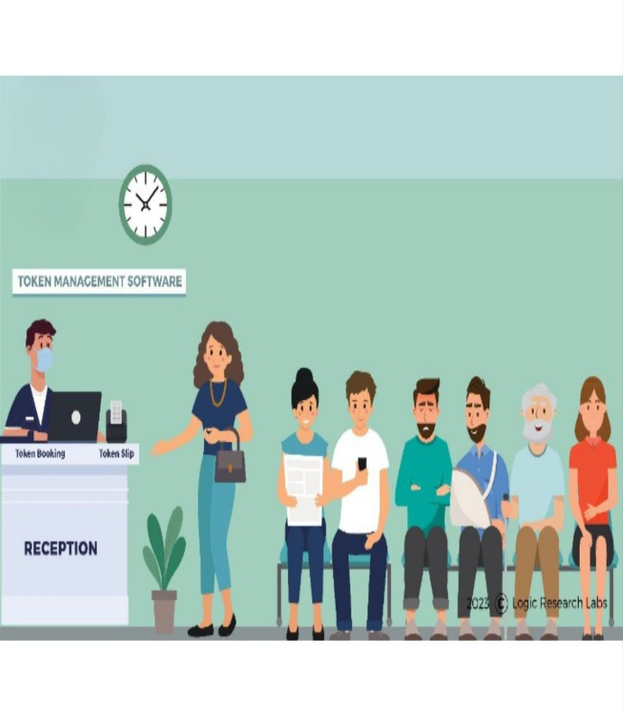
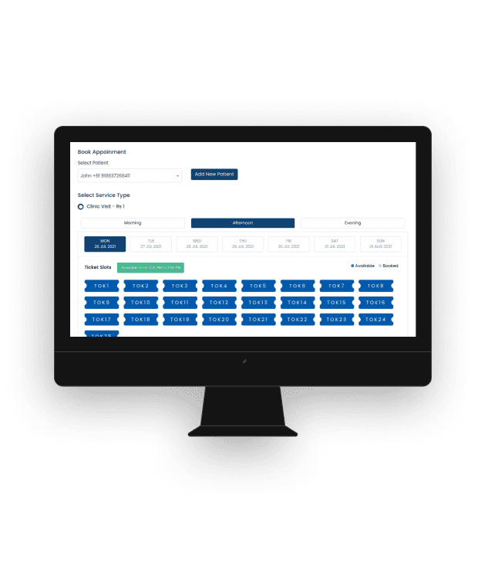
INTRODUCTION
This software is for automation small clinic token management
It can be used in any clinic for getting the token previously for consulting the doctor
It is also store and maintain the details of patients and their visiting details accordingly.
It is user friendly software
It cover complete cycle from patient appointment , registration ,patient history and doctor

Slide 4
OBJECTIVES AND SCOPE
To automate the manual procedure of managing clinic activities.
To develop website for doctors to easily access and view patient treatment records.
Boosts efficiency and resource management for doctors..
To reduce the crowd and congestion in clinics.
To prevent overbooking of appointments, ensuring smoother scheduling.

Slide 5
LITERATURE REVIEW
Abstract:
Clinic management systems function is to arrange and organize the inherent process in the health facility to be harmonized with the patient’s demand.
The user experience has been utilized to consider the critical aspect of successes of implementation related to human factor of mental model, which are utility, ease of use and efficiency.
The process of creating solutions for serving the patients have tendency to outsourcing IS management process towards IT-related company that has function to operate database and archive service.
Clinic management system is a computerized patient record system. The main purpose of the system is to reduce the burden of doctor and nurses and improve the patient records management

Slide 6
LITERATURE REVIEW
Appointment Scheduling:
This module is designed to have two sections patient section and staff section
Accessible to the authorized user.
Observation and Diagnosis:
After the appointment is confirmed
patient record goes to the observation
Online Consultation:
A messaging system where both patient and doctor
User Satisfaction:
Healthcare providers and administrative staff the success of a clinic management system.
Booking Appointment:
Many different types of businesses use some type of Web-based online appointment management system

Slide 7
LITERATURE REVIEW
Registration process:
Clinic Registration System is developed to improve the clinic management automates the workflow that happens in the clinic.
This system is considering all the activities in the clinic. Patient will make registration first.
If the patient never registered before, patient information collected and stored in the database.
However, if it is an existing patient the patient data is search-using the Registration ID or the Login ID.

Slide 8
PROBLEM STATEMENT
The healthcare industry faces challenges in efficiently managing and scheduling appointments with doctors. Patients often encounter long wait times, difficulty in finding available slots, and inefficiencies in the appointment booking process. Additionally, healthcare providers may struggle to optimize their schedules, leading to underutilization of resources and potential revenue loss. These challenges contribute to patient dissatisfaction, decreased access to timely care, and operational inefficiencies for healthcare providers.

Slide 9
ADVANTAGES
The system automates the manual procedure of managing
clinic activities.
Doctors can view their patients’ treatment records and
details easily.
It even generates an instant bill thus eliminates the need
of maintaining paper records for patient stay for each day.
The system is convenient and flexible to be used.
It saves their time, efforts, money and resources.
DISADVANTAGES
Requires large database.
The user has to manually keep updating the information
by entering the details in the system.

Slide 10
METHODOLOGY
start
User access website
User interface
Login/registration
Services

Slide 11
METHODOLOGY
Find a doctor
Token Generation
Token Display
Token Tracking
End

Slide 12
RESULT
Booking appointments becomes faster, so patients wait time is reduced and have a better experience.
The website helps manage appointments well, so the clinic doesn't get too crowded.
The clinic can see trends and patterns in patient appointments, helping them plan better for the future.

Slide 13
CONCLUSION
In conclusion , the implementation of clinic token management
system can lead to significant improvement in patient experience,
Staff productivity , appointment management and overall clinic
efficiency

Slide 14
THANK YOU

